Slide 1

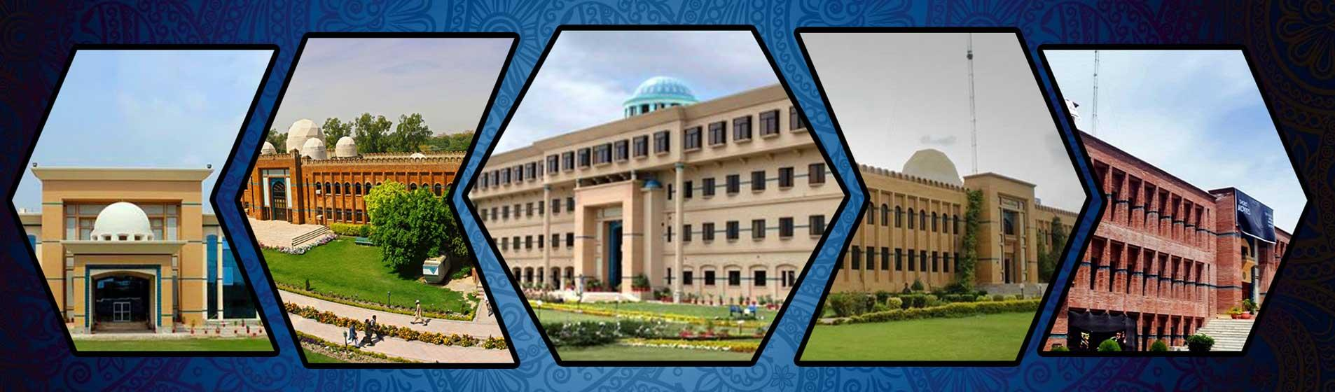
DATA SCIENCE
CS4048
Fast NUCES Peshawar
FAST: Where Talent Meets Technology & Knowledge Creates Opportunity.
Presented by Muhammad Zulqarnain
‹#›

Slide 4
Contact Details
Contact
Mr. Muhammad Zulqarnain, Lecturer, Computer Science department ,
Email: muhammad.zulqarnain@nu.edu.pk
Office: Room (office no 15,Admin block)
Office Hours: 10:00 am – 1:00 pm Tuesday and Wednesday.
Schedule
2 Classes of 1.5 hours
Course on google classroom
Class code: rzhscb6

Slide 5
Marks Distribution(tentatively)
Assessment Item | Number | Weight (%)
Quizzes | 5 | 10
Assignments/HWs | 4 | 12
Project | 1 | 8
Class participation |  | 5
1st Sessional Exam | 1 | 12.5
2nd Sessional Exam | 1 | 12.5
Final Exam | 1 | 40

Slide 6
Instructor Intro
Lecturer at FAST-NU (since Jan 2025–).
Lecturer at CUST Islamabad (Feb 2024– Dec 2024).
Research Assistant at KDD lab FAST-NU (June 2022- July 2023).
MS Data Science FAST Islamabad(Sept 2020-June 2023).
BS Computer Engineering Comsats Islamabad(Sept 2015-Jan 2020)
Research Interests: Data Science, Social Networking Analysis, Machine Learning, Deep Learning , computer vision.

Slide 7
Data information knowledge wisdom
Data: Any thing which is not necessarily meaningful to human being.
Raw facts/unprocessed information
The number 10 15 22 are data
Some one can think these are the lengths other may these are room numbers
Similarly 1.5 ,2.5 ,3.5 may represent mass of iron rods.

Slide 8
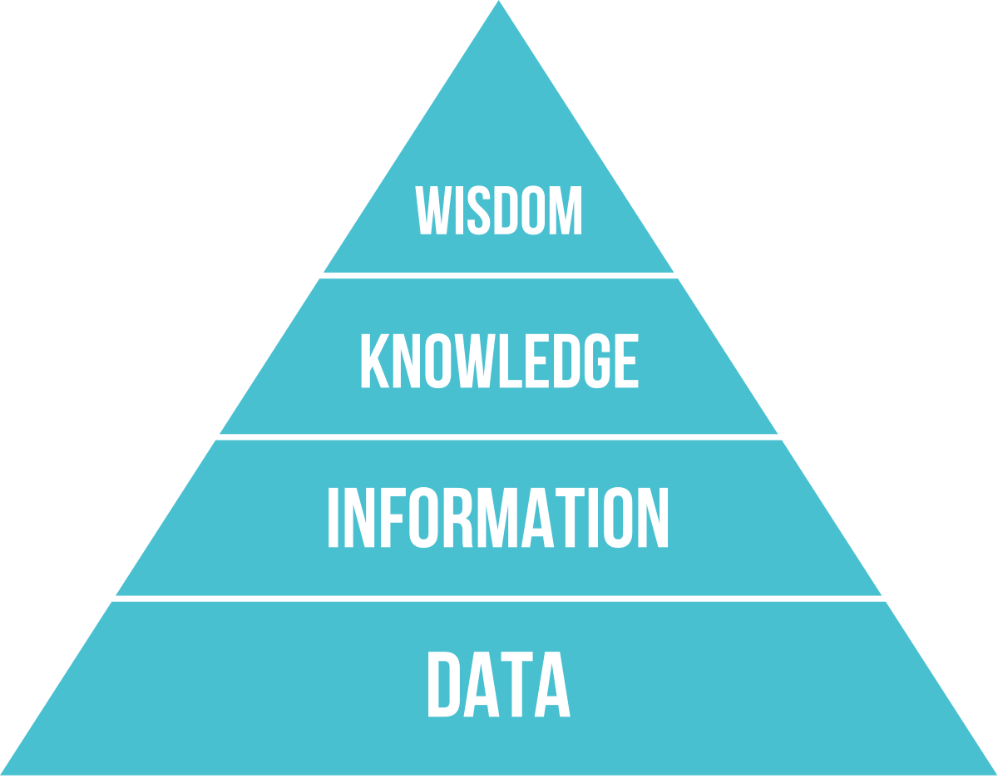
Information
Data processed to reveal its meaning
Information is meaningful
In today’s world accurate relevant and truly information is key to good decision making
Information Temperature (°C)
Data 10, 20, 30, 33,40
Notes:
Information TypeTemperature (°C)Data10, 20, 30, 40

Slide 9
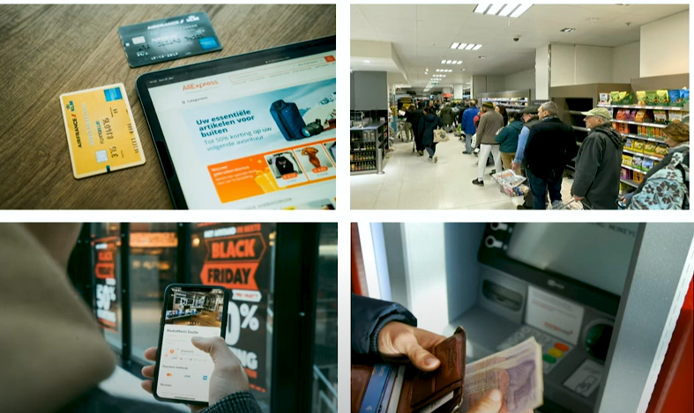
What is data Science
How much data you produce in a day?
What information is hidden in the data.
What that data is going?
Who own that data?

Slide 10
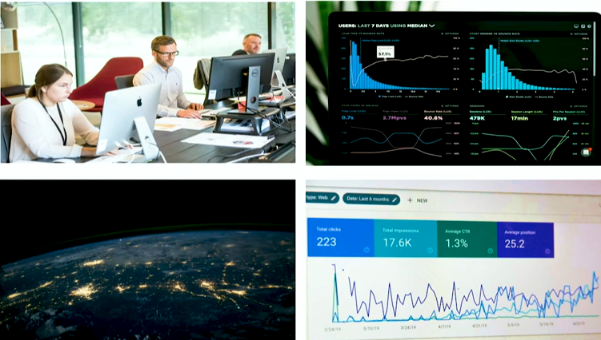
YOU are generating valuable data during all such activities producing valuable information. Not only for yourself but also for the businesses around the WORLD

Slide 11

Data Science Overview
Data science is a multi-disciplinary field that uses scientific methods, processes, algorithms, and systems to extract knowledge and insights from structured and unstructured data [1].
Employs techniques and theories drawn from many fields within the context of mathematics, statistics, computer science
[1] https://en.wikipedia.org/wiki/Data_science

Slide 12
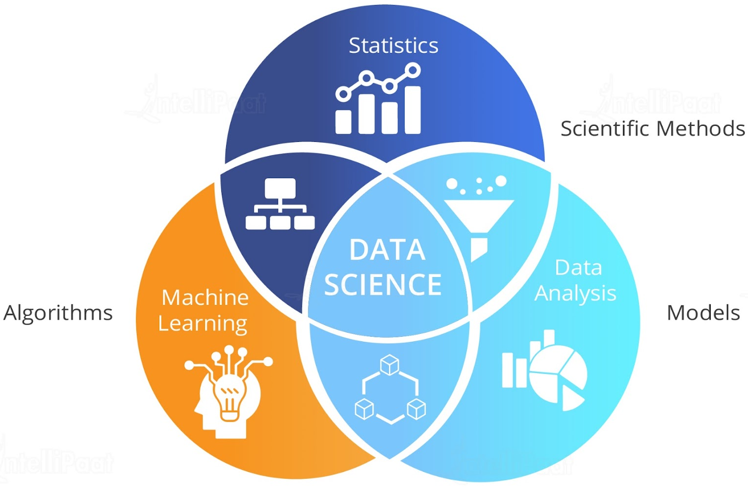
What is Data Science
Use machine learning and statistical models to analyze the data.

Slide 13

What is data Science
The process of extracting knowledgeable insights from data using scientific methods and tools
https://jamiahamdardonline.in/blog/what-is-the-use-of-data-science.html

Slide 14
Components of Data Science
There are four major components of data science
Data Strategy
Data Engineering
Data Modeling and Analysis
Data visualization and operationalization

Slide 15
Data Science Careers
1)Data Scientist
Focus: Predictive modeling & extracting insights.
Skills: Python, R, Machine Learning, Statistics, Data Visualization.
Tools: TensorFlow, Scikit-learn, Jupyter Notebooks.
Responsibilities:
Develop ML models.
Perform advanced analytics.
Present findings to stakeholders.
2)Data Engineer
Focus: Building & maintaining data infrastructure.
Skills: Python, SQL, Big Data Tools (Hadoop, Spark).
Tools: Apache Airflow, Databricks, Kafka.
Responsibilities:
Design & optimize pipelines.
Ensure data quality & availability.
Collaborate with analysts & scientists.
3) Data Analyst
Focus: Analyzing & reporting data for business decisions.
Skills: Excel, SQL, Tableau, Statistics.
Tools: Tableau, Power BI, Python (Pandas, Matplotlib).
Responsibilities:
Create dashboards & reports.
Identify trends & patterns.
Provide actionable insights.
4) Business Analyst
Focus: Aligning business needs with technical solutions.
Skills: Business Acumen, Process Analysis, Data Interpretation.
Tools: Microsoft Office Suite, Jira, Power BI.
Responsibilities:
Gather & analyze requirements.
Propose technical solutions.
Collaborate with stakeholders.

Slide 16
What is Data Science
Supervised learnings
Classification
Regression
Unsupervised learnings
Clustering
Association Rule mining
Dimensionality Reduction
Programming Language
Data Analysis
Python
R
Java
Exploratory data analysis
Data Wrangling
Machine learning
DS
Reinforcement learning
Deep Learning
Data Visualization
Tableau
Power BI
Matplotlib, seaborn
Math
Web scraping
IDE
Statistics
Linear Algebra
Differential Calculus
Beautiful Soup
Scrapy
URLlib
Jupyter Notebook
Spyder
PyCharm
R-Studio
‹#›

Slide 17
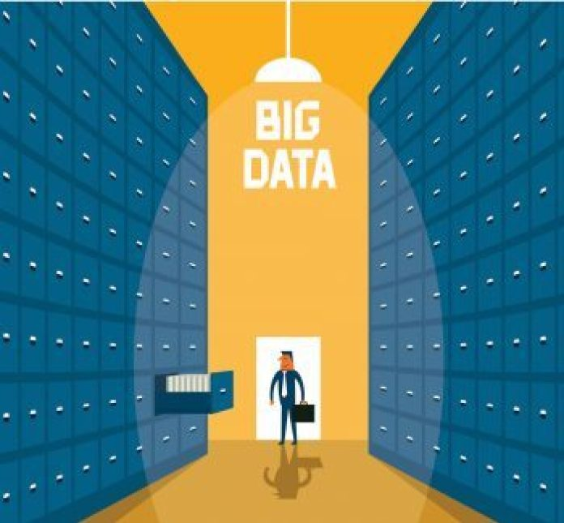
Introduction to Big Data
‹#›

Slide 18
Big Data Definition
No single standard definition…
“Big Data” is data whose scale, diversity, and complexity require new architecture, techniques, algorithms, and analytics to manage it and extract value and hidden knowledge from it…

Slide 19
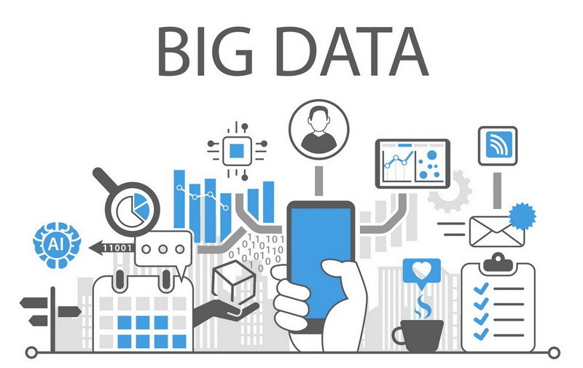
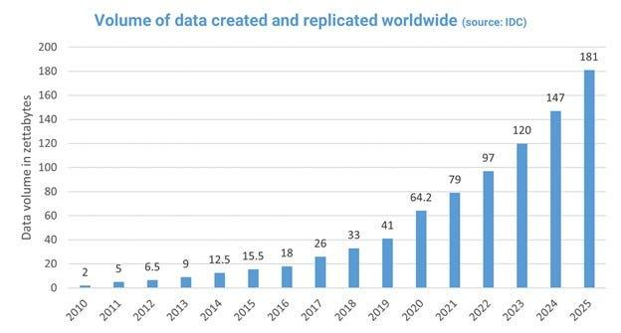
Big data continue
Big Data is a collection of data that is huge in volume, yet growing exponentially with time.
It is a data with so large size and complexity that none of traditional data management tools can store it or process it efficiently. Big data is also a data but with huge size.

Slide 20
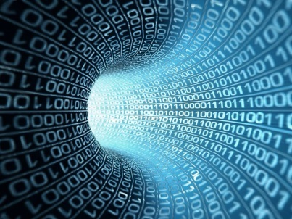
Why Now?
Technological advances in devices, software, and networking give rise to digital data that are rich in variety, volume, velocity and complexity, generated and collected at an unprecedented scale

Slide 21
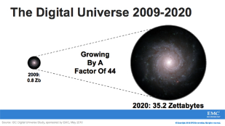
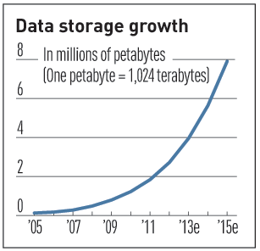

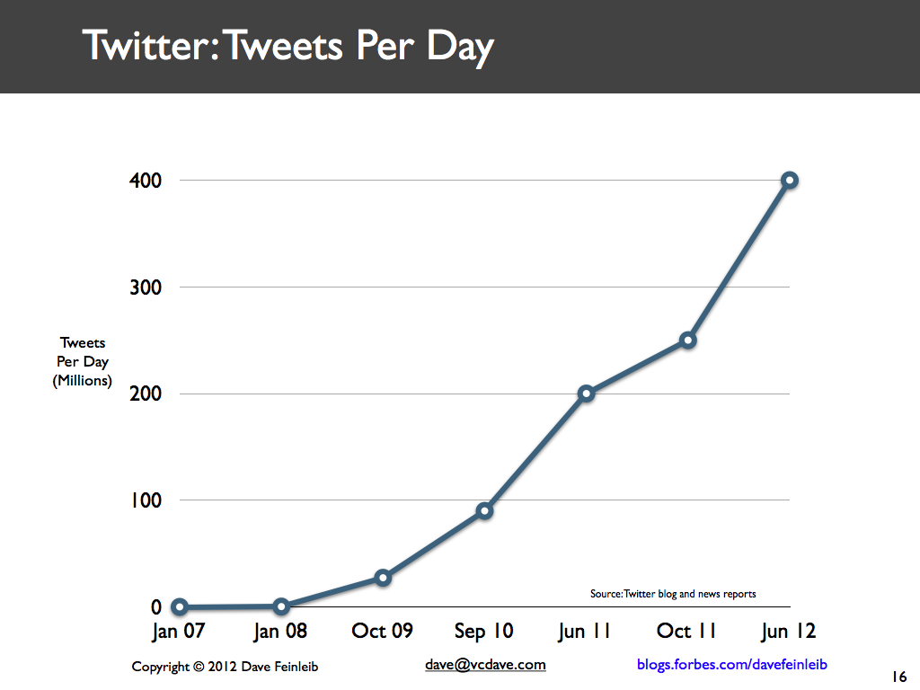
Characteristics of Big Data: 1-Scale (Volume)
Data Volume
44x increase from 2009 2020
From 0.8 zettabytes to 35zb
Zettabytes: A billion terabytes or a trillion gigabytes
Data volume is increasing exponentially
Exponential increase in collected/generated data

Slide 22
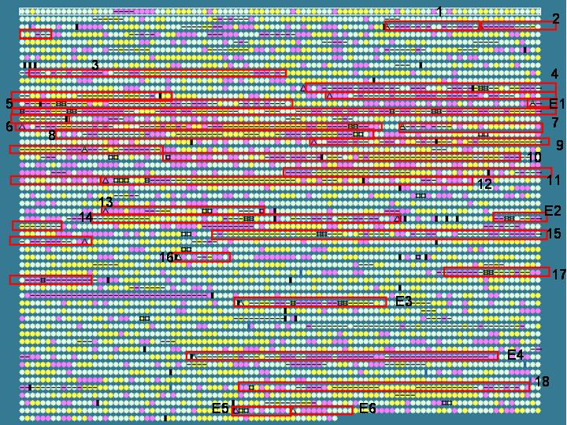
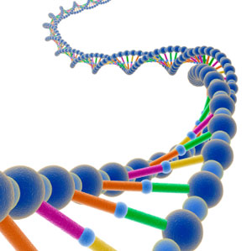
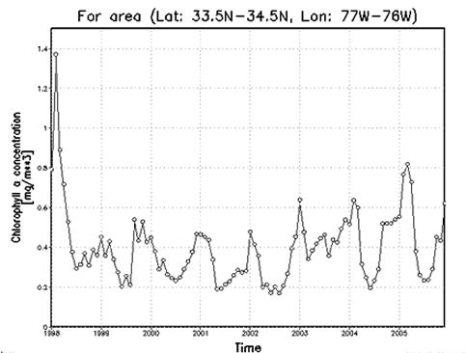

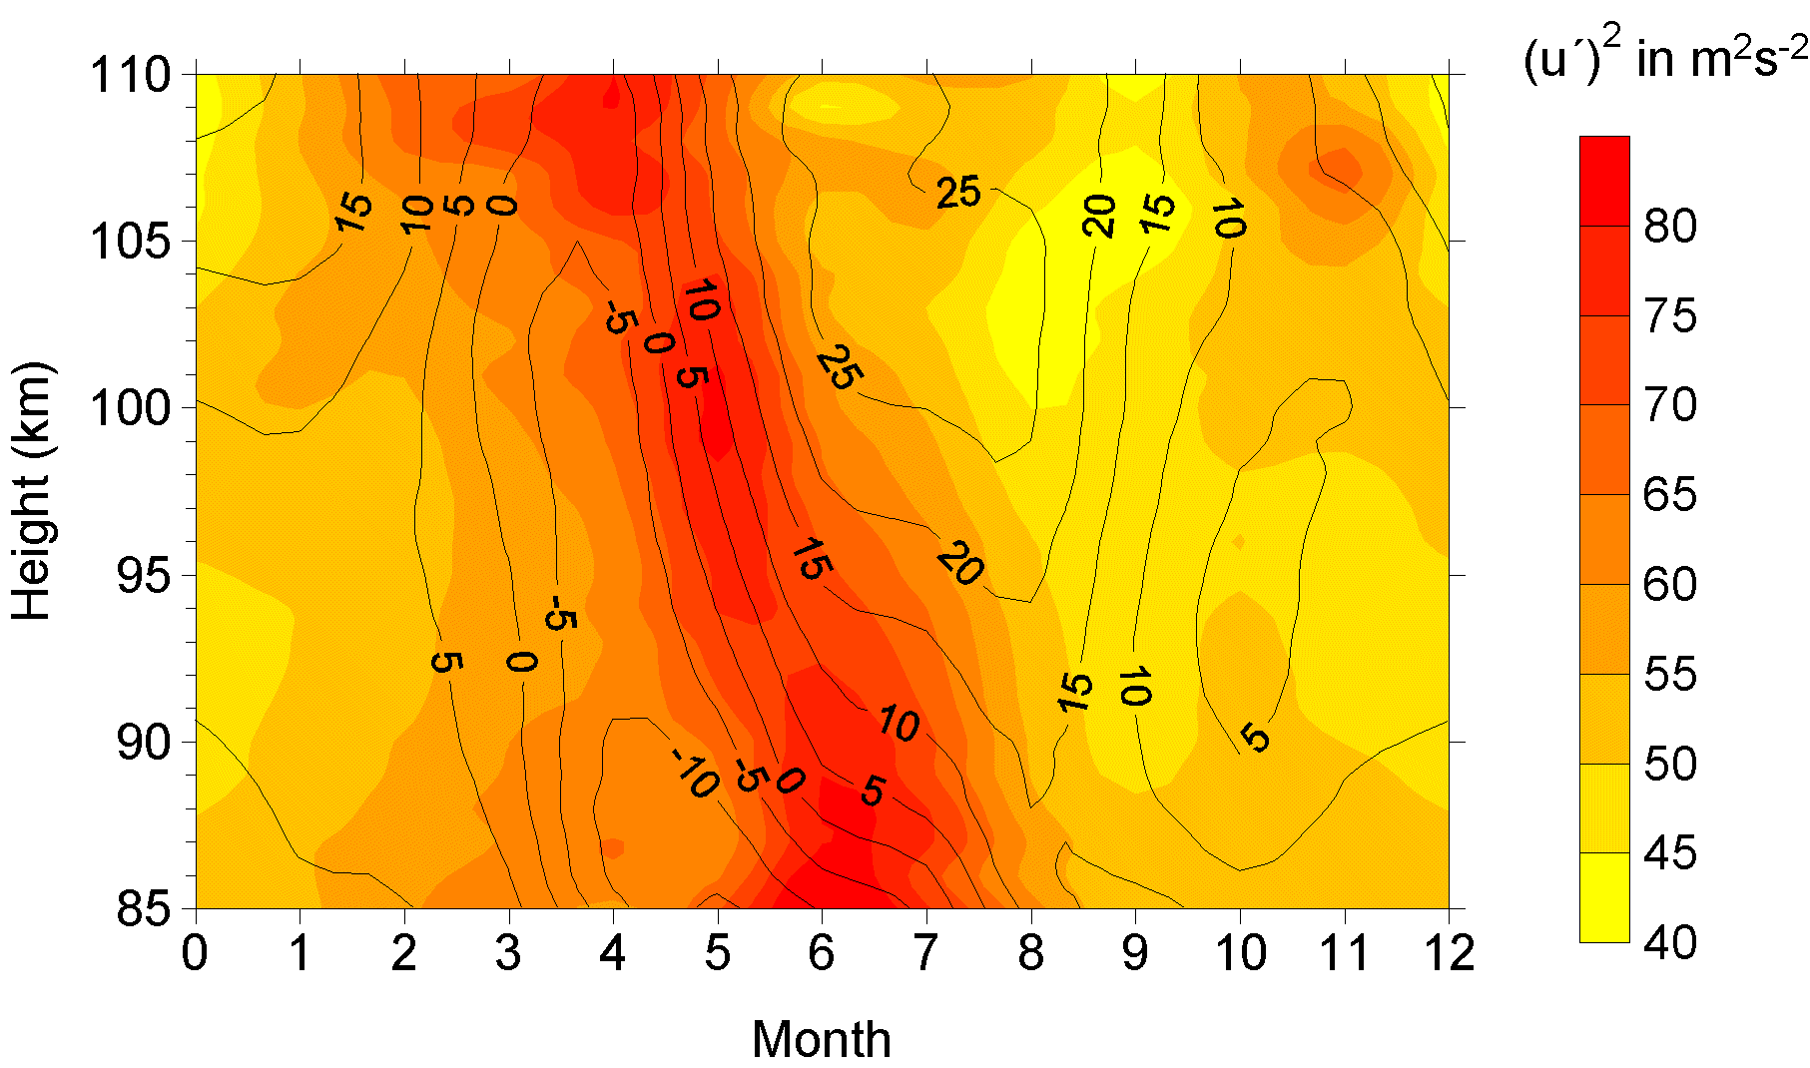
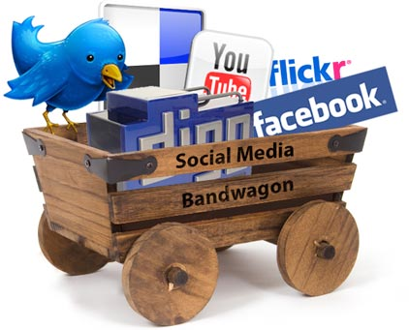
Characteristics of Big Data: 2-Complexity (Variety)
Various formats, types, and structures
Text, numerical, images, audio, video, sequences, time series, social media data, multi-dim arrays, etc…
Static data vs. streaming data
A single application can be generating/collecting many types of data
To extract knowledge🡺 all these types of data need to linked together

Slide 23

Characteristics of Big Data: 3-Speed (Velocity)
Data is begin generated fast and need to be processed fast
Online Data Analytics
Late decisions 🡺 missing opportunities
Examples
Fraud Detection : As billions of users use credits cards, we want on an instant stop the transaction from a fraudster
Business Intelligence : Upon news from twitter news to weather forecast affecting your business workflow, you want to reconfigure your supply chain
Healthcare monitoring: sensors monitoring your activities and body should react instantaneous under any abnormal measurement

Slide 24
Characteristics of Big Data: Veracity (Accuracy)
Data may be faulty or non-trustworthy
Causes:
Instrument quality
Ambiguity
Human error
Inconsistency/incomplete
Deception
…
Examples
Twitter : Data completely messy

Slide 25
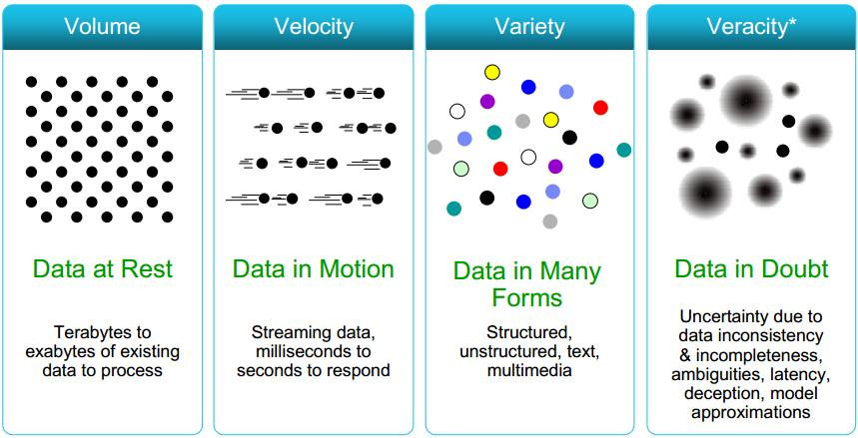
4V’s

Slide 26
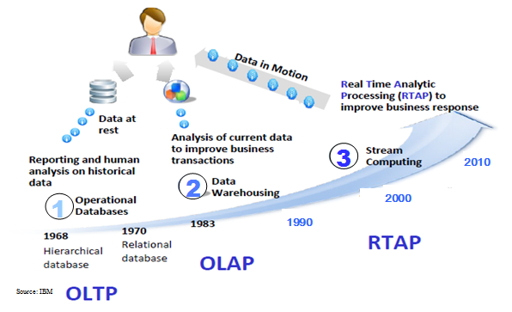
Harnessing Big Data
OLTP: Online Transaction Processing (DBMSs)
OLAP: Online Analytical Processing (Data Warehousing)
RTAP: Real-Time Analytics Processing (Big Data Architecture & technology)

Slide 27
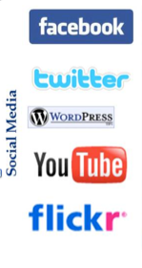
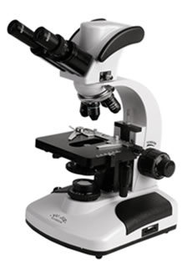

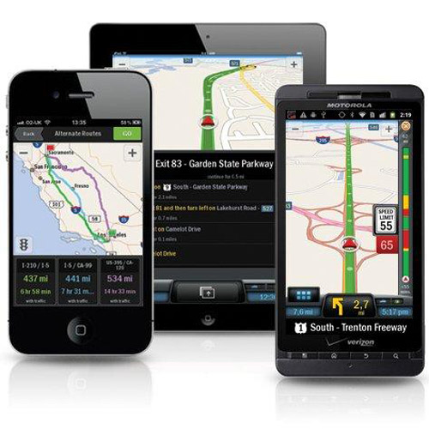
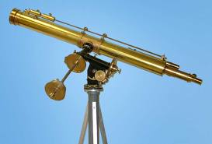
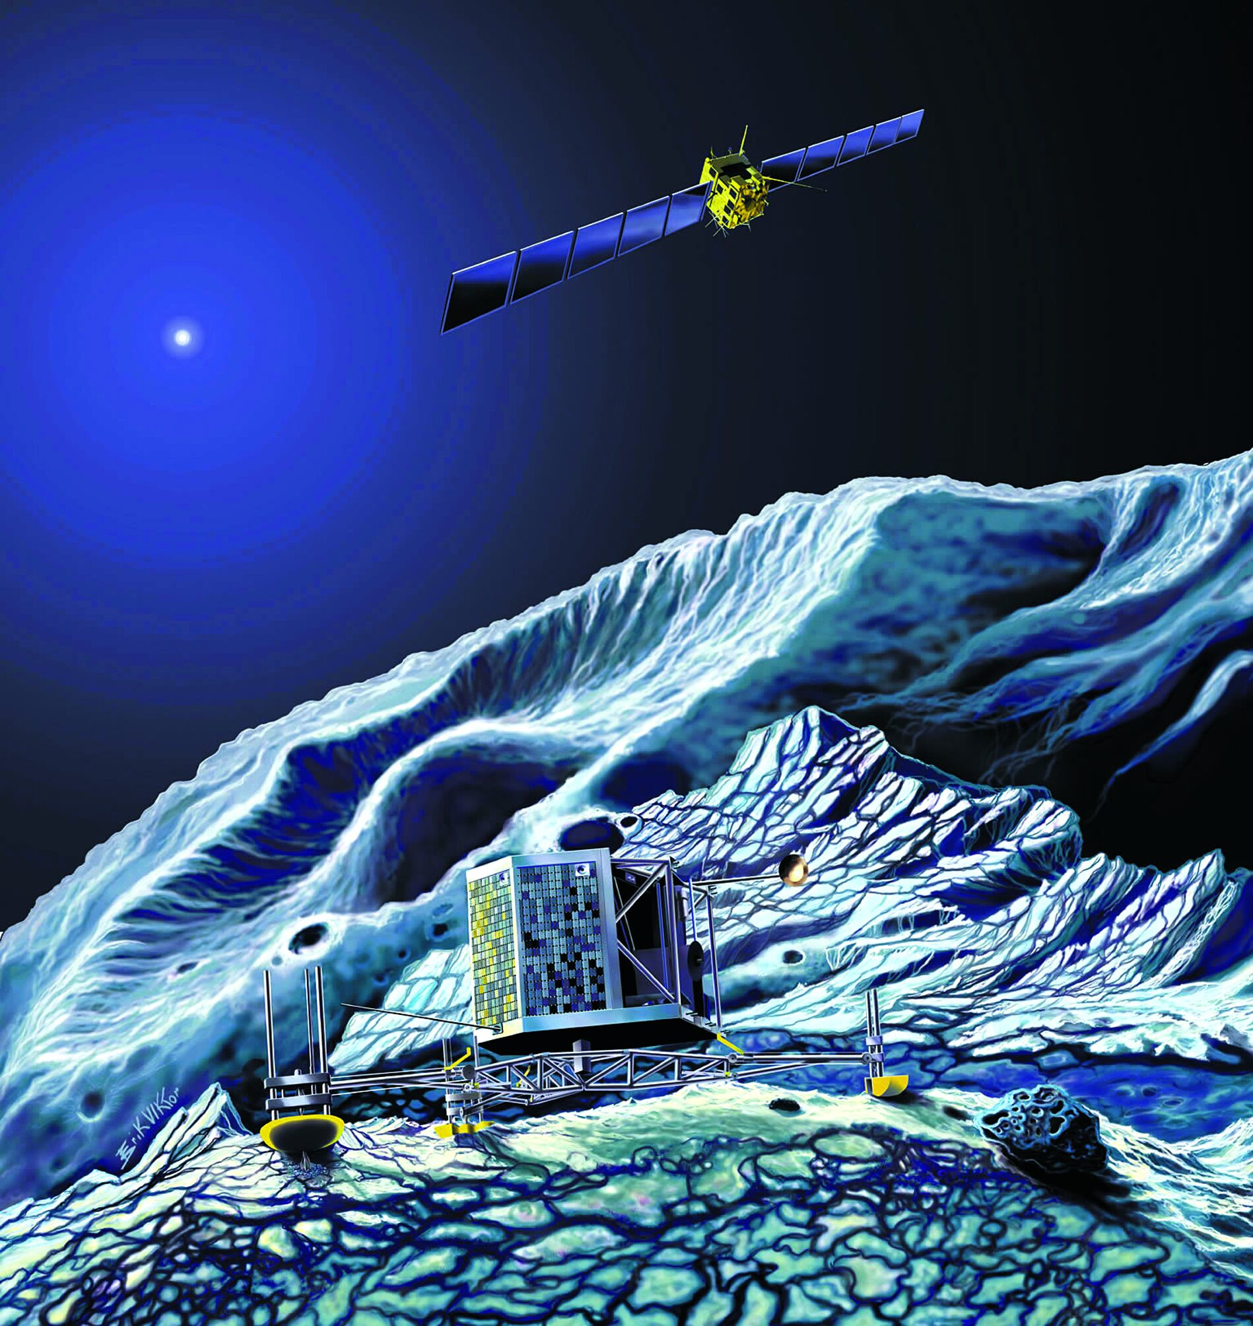
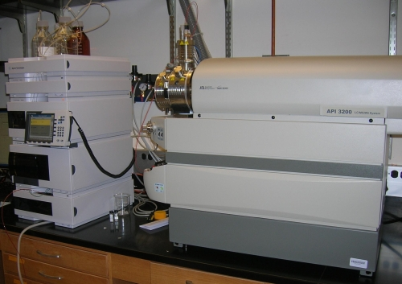
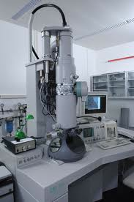
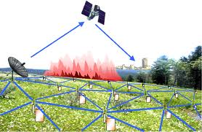
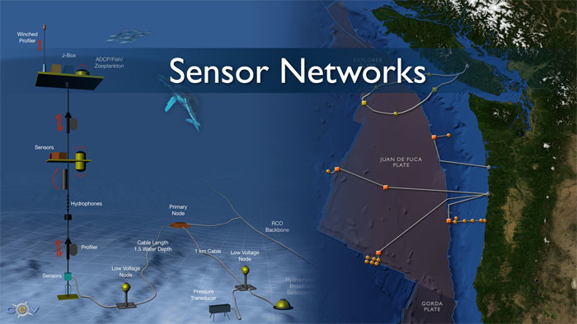
Who’s Generating Big Data
Mobile devices
(tracking all objects all the time)
Social media and networks
(all of us are generating data)
Scientific instruments
(collecting all sorts of data)
Sensor technology and networks
(measuring all kinds of data)
The progress and innovation is no longer hindered by the ability to collect data
But, by the ability to manage, analyze, summarize, visualize, and discover knowledge from the collected data in a timely manner and in a scalable fashion

Slide 28
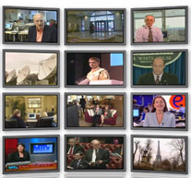

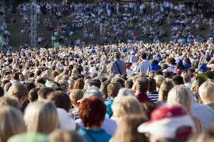

The Model Has Changed…
The Model of Generating/Consuming Data has Changed
Old Model: Few companies are generating data, all others are consuming data
New Model: all of us are generating data, and all of us are consuming data

Slide 29
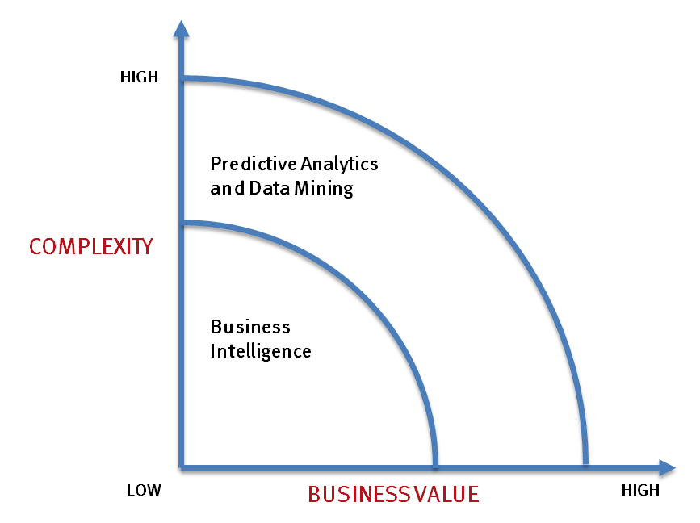
What’s driving Big Data
- Optimizations and predictive analytics
- Complex statistical analysis
- All types of data, and many sources
- Very large datasets
- More of a real-time
- Ad-hoc querying and reporting
- Data mining techniques
- Structured data, typical sources
- Small to mid-size datasets

Slide 30
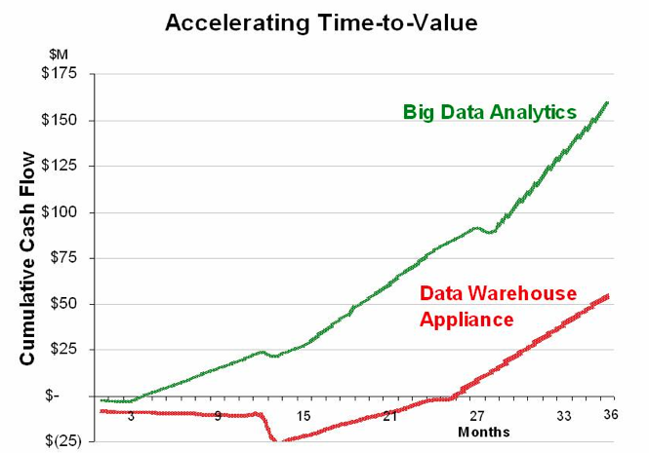
Value of Big Data Analytics
Big data is more real-time in nature than traditional DW applications
Traditional DW architectures (e.g. Exadata, Teradata) are not well-suited for big data apps
Shared nothing, massively parallel processing, and scale-out architectures are well-suited for big data apps

Slide 31
What Sectors Can Benefit?
‹#›
Businesses
Transportation
Science
Engineering
Governments
Energy
Healthcare
Education
Entertainment
‹#›

Slide 32
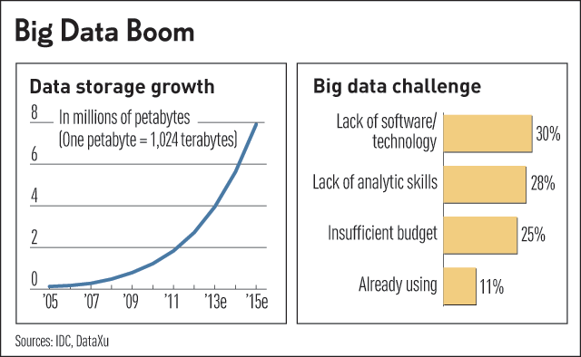
Challenges in Handling Big Data
The Bottleneck is in technology
New architecture, algorithms, techniques are needed
Also in technical skills
Experts in using the new technology and dealing with big data

Slide 33
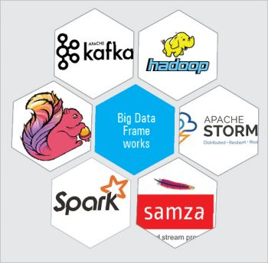
Big Data Frameworks
Apache Hadoop: open source, scalable and fault-tolerant framework written in Java. processing framework that exclusively provides batch processing, and efficiently processes large volumes of data on a cluster of commodity hardware
Apache Storm: stream processing framework that focuses on extremely low latency and is perhaps the best option for workloads that require near real-time processing. It can handle very large quantities of data and deliver results with less latency than other solutions.
Apache Spark: general purpose and lightning-fast cluster computing system. It provides high-level APIs like Java, Scala, Python, and R, and is a tool for running Spark applications. It is 100 times faster than Big Data Hadoop and ten times faster than accessing data from the disk. It can be integrated with Hadoop and can process existing Hadoop HDFS data

Slide 34

Questions?

Slide 35
Thank You ☺

